Slide 1

advance of the sea

Slide 2
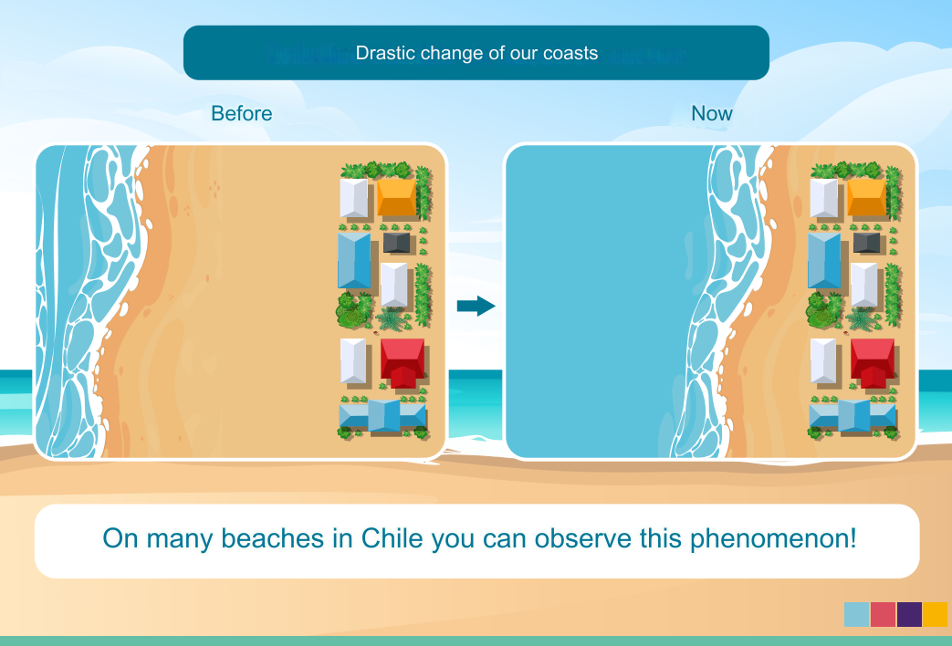
Infographic “Sea level rise”
Notes:
Show the “sea level rise” infographic found in full in resources

Slide 3
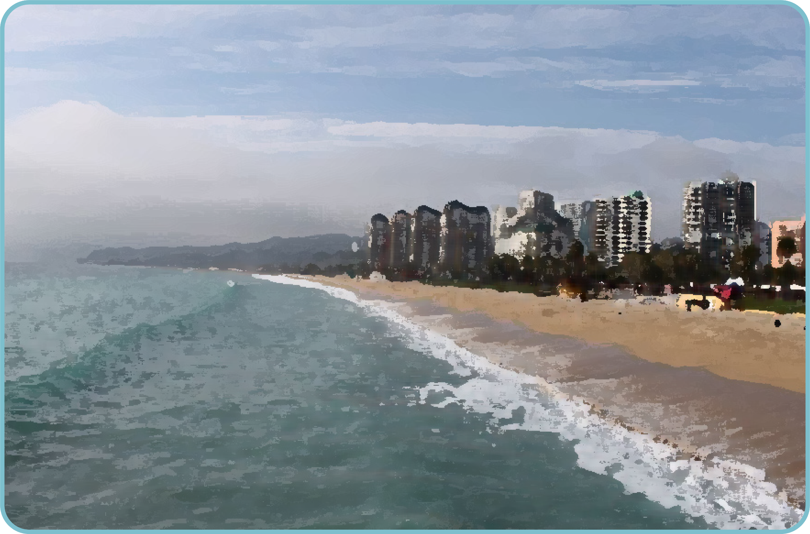
Situation: Advance of the sea
To start…
What do we understand by climate change and how does it affect sea level rise?
How does the rise in sea level influence the coast of Chile?
Have you noticed the advance of the sea on any beach? Or have you heard about this?

Slide 4
Situation: Advance of the sea
Read the following situation:
Different predictions have been made about the speed at which the sea will advance in certain areas of the Chilean coast. Below are two of them:
In Antofagasta the rate of advance of the sea will be 6 meters every 10 years .
In Constitución the rate of advance of the sea will be 8 meters every 10 years.

Slide 5

Situation: Advance of the sea
Read the following situation:
Different predictions have been made about the speed at which the sea will advance in certain areas of the Chilean coast. Below are two of them:
In Antofagasta the rate of advance of the sea will be 6 meters every 10 years .
In Constitución the rate of advance of the sea will be 8 meters every 10 years.
What is the rate of advance of the sea for each area?
What would be the progress after 20 years?
because?

Slide 6
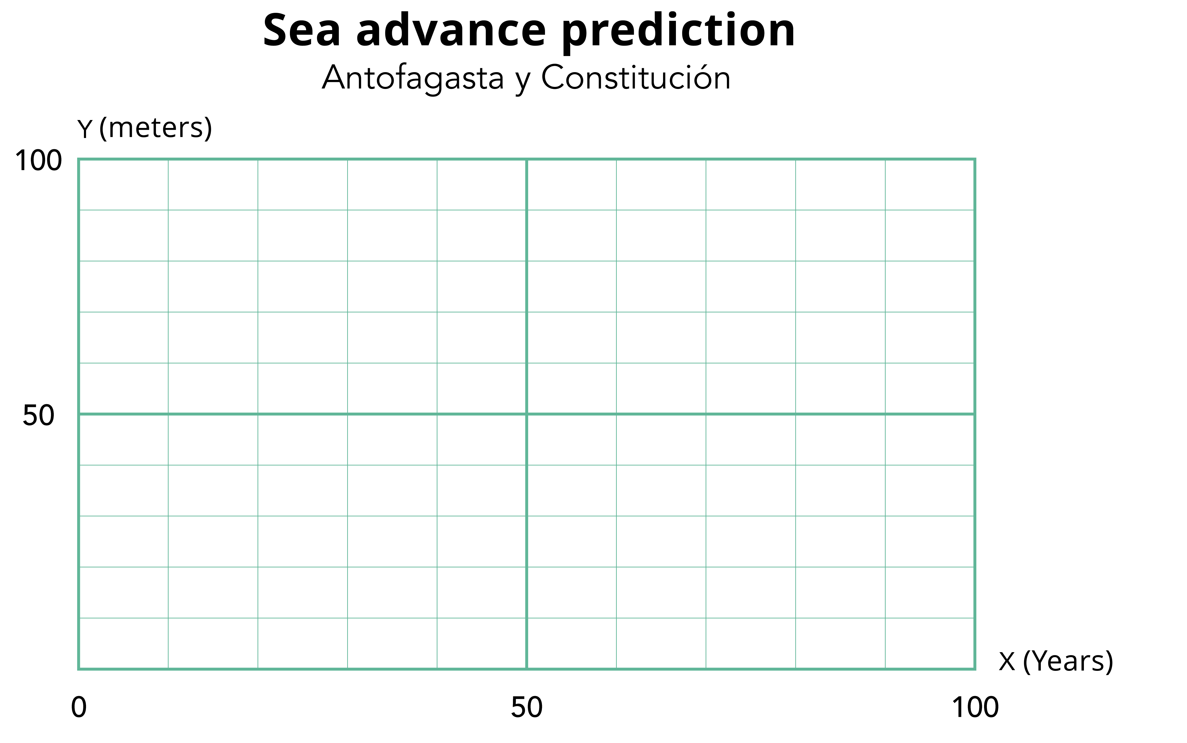
Situation: Advance of the sea
Let's analyze the situation
1. Draw the graphs of the predictions of the advance of the sea for each of the coastal areas mentioned.

Slide 7
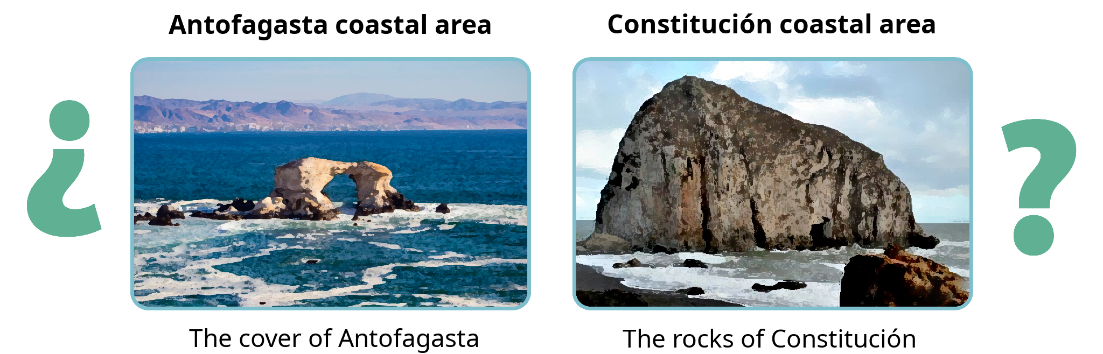
Situation: Advance of the sea
Let's analyze the situation
2. In which coastal area is the sea advancing the fastest? How does it relate to the graph?

Slide 8
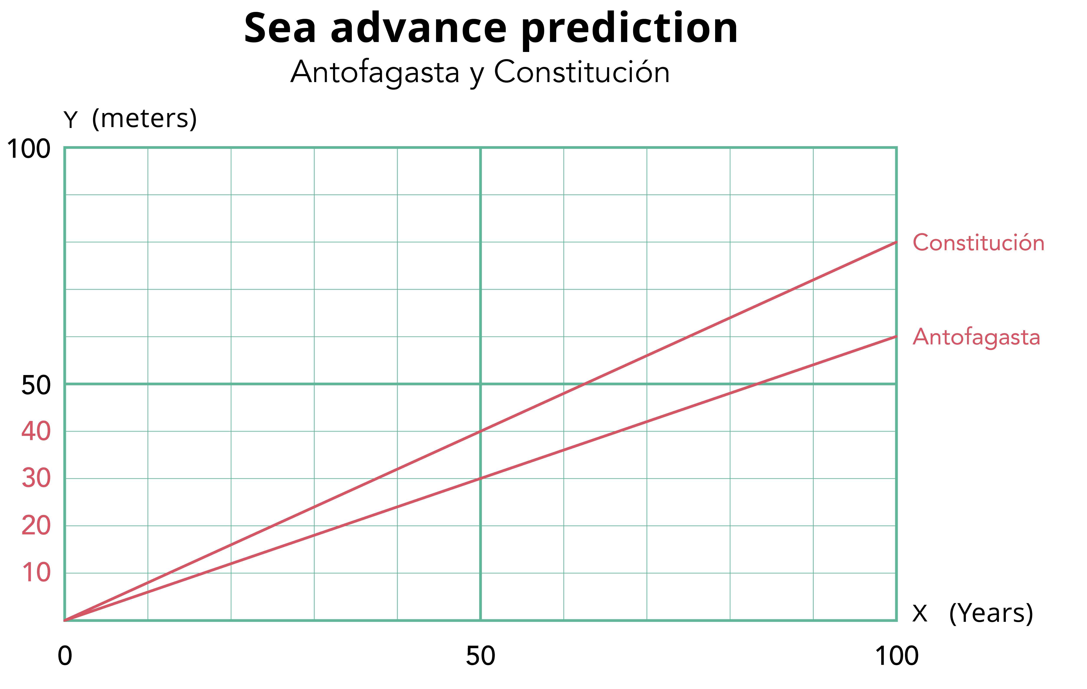
Situation: Advance of the sea
Let's analyze the situation
2. In which coastal area is the sea advancing the fastest? How does it relate to the graph?

Slide 9
Situation: Advance of the sea
Let's analyze the situation
The advance of the sea in the coastal area of Constitución occurs at a faster rate than in the coastal area of Antofagasta, since every 10 years the sea advances 8 meters, while in Antofagasta it advances 6 meters in the same period of time.
The line of advance of the sea in Constitución is above the line of advance of the sea in Antofagasta.

Slide 10
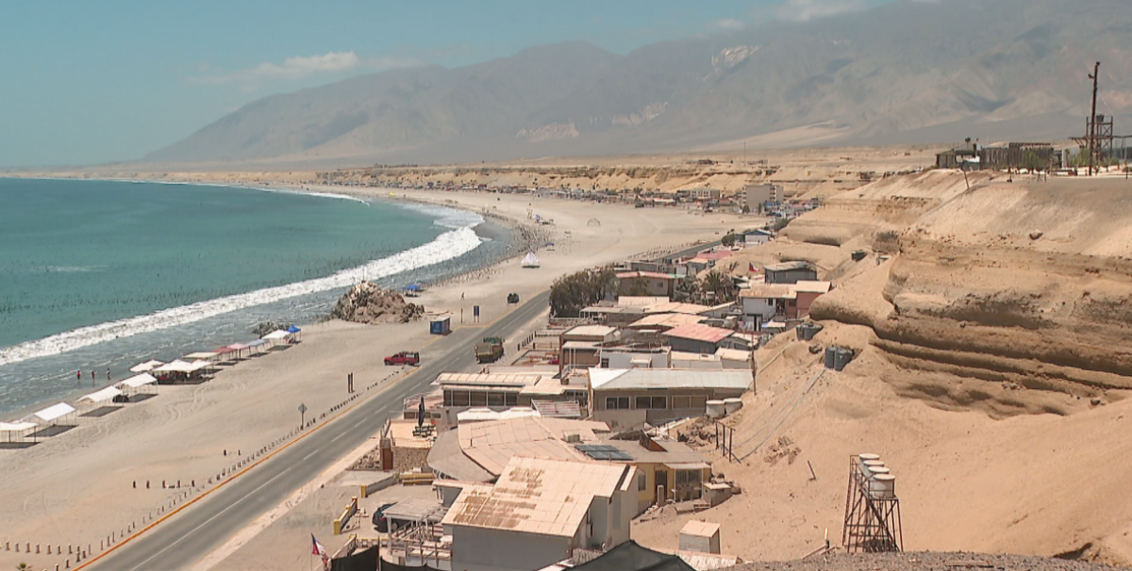
Situation: Advance of the sea
Let's analyze the situation
3. How many meters will the sea have advanced in Antofagasta and Constitución in 50 more years?

Slide 11
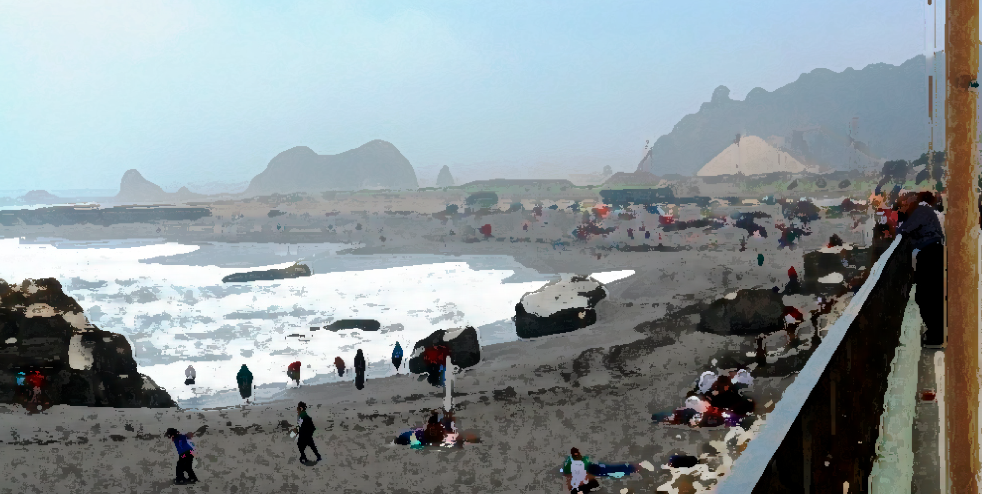
Situation: Advance of the sea
Let's analyze the situation
4. How many meters will the Antofagasta and Constitución sea have advanced in 30 more years?

Slide 12

Situation: Advance of the sea
Let's analyze the situation
5. Write a formula that describes the relationship between time and the advance of the sea for the coastal areas of Antofagasta and Constitución.

Slide 13
Situation: Advance of the sea
Let's analyze the situation
6. Use the formulas to calculate the advance of the sea after 2 years.
In Antofagasta
In Constitution

Slide 14
Situation: Advance of the sea
Let's analyze the situation
6. Use the formulas to calculate the advance of the sea after 2 years.
In Antofagasta
In Constitution
$y=0,6⋅x$
$y=0,8⋅x$
$y=0.6⋅2$
$y=0,8⋅2$
$y=1,2$
$y=1,6$
In 2 more years, the sea will advance 1.2 meters (1 m and 20 cm).
In 2 more years, the sea will advance 1.6 meters (1 m and 20 cm).
In 2 more years, the sea will advance 1.2 meters (1 m and 20 cm).
In 2 more years, the sea will advance 1.2 meters (1 m and 20 cm).

Slide 15
Situation: Advance of the sea
Let's analyze the situation
7. In 2023, houses have been built a few meters from the beach in the coastal area of Antofagasta and in Constitución .
    In Antofagasta, the house is 15 meters from the coast.
In Constitución, the house is 20 meters from the coast.
a) In each case, write on the signs the year in which the sea will advance the indicated meters
b) Which house will the sea reach first? In what year?

Slide 16
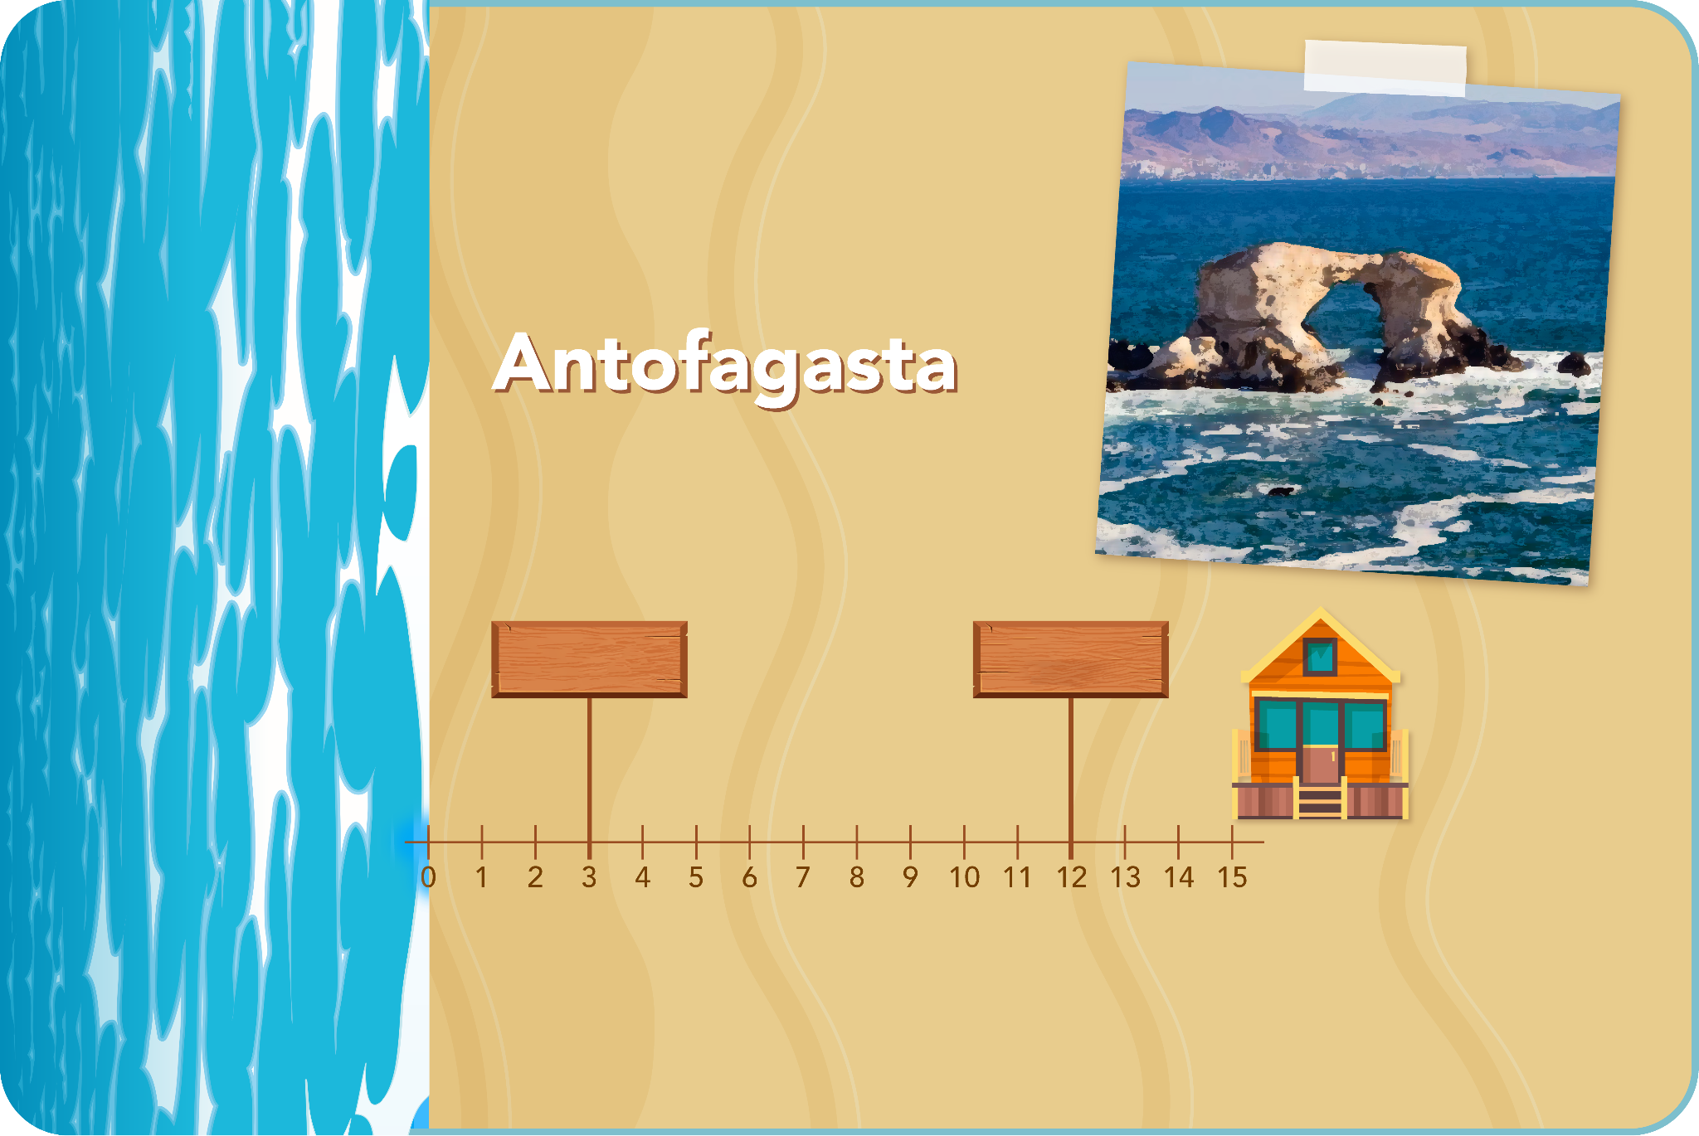
Situation: Advance of the sea
Let's analyze the situation
a) In each case, write on the signs the year in which the sea will advance the indicated meters

Slide 17
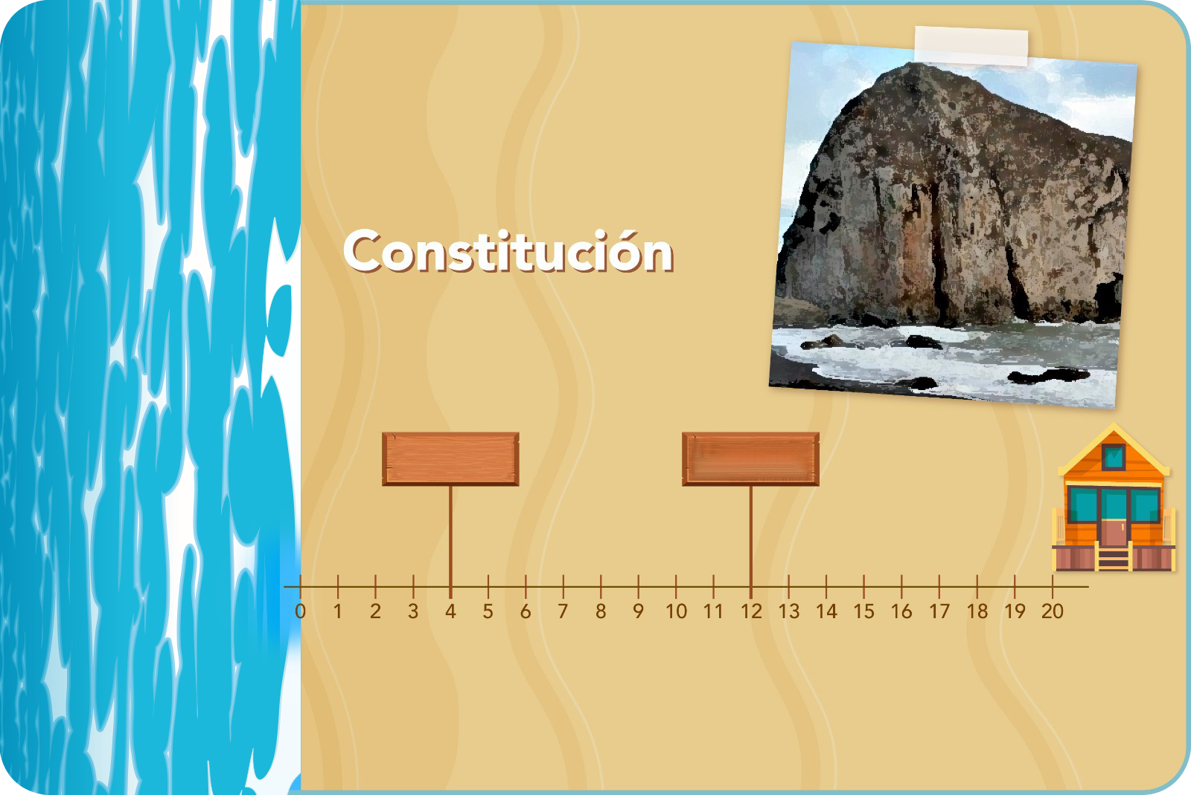
Situation: Advance of the sea
Let's analyze the situation
a) In each case, write on the signs the year in which the sea will advance the indicated meters

Slide 18
Situation: Advance of the sea
Let's analyze the situation
b) Which house will the sea reach first? In what year?

Slide 19
Situation: Advance of the sea
Let's analyze the situation
b) Which house will the sea reach first? In what year?
In Antofagasta
In Constitution
In the year 2048 the sea reaches the house that is 15 meters from the coast
In the year 2048 the sea reaches the house that is 20 meters from the coast
In both houses the sea will arrive in the year 2048!

Slide 20
Some ideas and conclusions:
The predictions given about the advance of the sea in coastal areas establish a relationship of direct proportionality between the variables. That is, it is assumed that the rate of advance of the sea is constant. Given this relationship, the corresponding lines were drawn from the origin to the points found.
The proportionality constant of the advance of the sea in Constitución is greater than that of Antofagasta

Slide 21
Some ideas and conclusions:
To obtain the algebraic expression of direct proportionality for each coastal zone, it is necessary to find the proportionality constant. To do this, we identify the progress in meters when a year has passed , that is, the value of y when x=1 .
In the case of Antofagasta, where "a sea advance of 6 meters every 10 years" is predicted, we can express it as "a sea advance of 0.6 meters per year." Similarly, for Constitución, we can express it as "a sea advance of 0.8 meters per year."
In Antofagasta
( x years, y meters)
In Constitution
( x years, y meters)
$y=0,6⋅x$
$y=0,8⋅x$

Slide 22
Some ideas and conclusions:
Using direct proportionality formulas, we can determine the advance in meters of the sea in each area after a number of years. In addition to calculating the number of years necessary for the advance of the sea to reach a certain amount in meters. For example:
In Antofagasta
$y=0,6⋅x$
$y=0,6⋅3$
$y=1,8metros$

Slide 23

Some ideas and conclusions:
Becoming aware of the rise in sea level as a result of climate change is essential to adopt precautionary measures and reduce the impact and consequences for the population and the environment.

Slide 24
advance of the sea

